Slide 1
Pharmacovigilance Projects Project Management Concerns
August 2023

Slide 2
Lessons Learned
Our approach is based on Agile Scrum, but in our Lessons Learned, we identified that we are not adhering to several Scrum ceremonies, like Sprint Reviews and Retrospectives.
We are using GitLab, which has pros and cons, depends on how you use it.
Perhaps Kanban is a more appropriate approach?
Kanban is a workflow management method that organizes and improves workflow. Kanban originated with Toyota in the late 1940s as a scheduling system for just-in-time manufacturing. It helps us visualize work in progress and improve workflow continuously, by representing the state of each piece of work on a single board that team members can refer to at any time.
What we are currently doing is more like Kanban than Agile Scrum.

Slide 3
Recommendations
For our next iteration for Medical Devices, experiment with using a GitLab Milestone to represent work in progress or a feature release, instead of two-week sprints.
Rely on default GitLab Board columns for Unstarted, Ongoing, Completed
Minimize Labelled Lists to Decision Required, Analysis Required, Ready to Review.
Add a “--- Ready ---” line to Unstarted column in Issues Board and use this as our Product Backlog in the Issues and Milestone Boards.

Slide 4
Product Backlog, Release Milestones, Production
No additional label for Product Backlog
New issues are already unassigned, so there is no need to do any additional labelling
Create New User Story in Product Backlog (ie an unassigned issue)
User Story is unassigned and below Ready line
Elaborate User Story (ie make them ready for development)
Pull User Stories into Release Backlog
User Stories can be pulled into a new Milestone as Release scope
Elaborated User Story is moved above Ready line
Review Changes
Developed features are reviewed by the client, PO
…then pushed to Production
Develop Product Features
User Stories are claimed by developers & developed
…then closed
Simplified Elaboration
Simplified Develop and Release Flow
New milestones for Product Releases
Timeboxed by planned start and end date
We can pull in stories during development
What if developers closed issues?
They can be reopened if necessary
Better representation of WIP

Slide 5
Kanban 101
WIP
Flow
Respect
Efficiency
Key Characteristics of Kanban
Workflow transparency: Kanban uses a board to show the different stages of work and the status of each work item. This helps team members and stakeholders see the flow of work and identify any bottlenecks or blockers.
Focus on completing instead of starting work: Kanban limits the amount of work in progress (WIP) in each stage to prevent multitasking and context switching. This helps team members concentrate on finishing current tasks before starting new ones.
Flow efficiency: Kanban aims to optimize the time that work items spend in value-adding activities rather than waiting or being transferred. This helps reduce lead time and increase customer satisfaction.
Respect for current roles and processes: Kanban does not prescribe any specific roles or processes for teams. Instead, it respects the existing ones and encourages teams to experiment and improve them gradually. Kanban enhances efficiency of these processes using boards, cards, columns and limits.

Slide 6
Kanban 101
GitLab gives us a board and transparency, but we need to keep it simple and uncluttered.
GitLab has support for:
Boards: GitLab offers Milestone Boards and Issue Boards.
Cards: GitLab offers Issues and Incidents.
Columns: By default, a Milestone Board has Unstarted, Ongoing, and Completed columns, which can be added to using Labels and Lists.
Limits: Kanban leverages Cumulative Workflow charts, but we can approximate this by limiting the number of WIP cards.
Boards
Cards
Columns
Limits
Milestones
Issue Boards
Issues
Incidents
Milestones have Unstarted, Ongoing, Completed columns
Lists and Labels enhance this
Charts are Premium
Count cards in a column

Slide 7

Kanban 101
Kanban is not…
…based on Sprints: Kanban does not have sprints or time-boxes. Kanban uses a kanban board to visualize and manage the flow of work from the product backlog to completion.
Using Sprints allows us to measure velocity, avoid carrying over work between iterations, estimate and review work with Product Owner.
These things may not be as valuable for a smaller development team.
…based on Story Points: Story points are a way of estimating issues in Scrum, but they are not effective or required in Kanban. Kanban prioritizes flow over velocity.
…a Standalone Framework: Kanban is used in combination with other methods or frameworks, such as Scrum, Lean, Agile, or Just-in-Time.
…not a Process Framework: Kanban does not prescribe specific roles, ceremonies, artifacts, or rules. It is a management method that should be applied to an existing process.
…not a Software Delivery Lifecycle: Kanban does not define any phases or stages of work (planning, design, development, testing, deployment). Instead, focus is on managing flow of work from backlog to completion.
Process Framework
Story Points
Sprints

Slide 8
Proposed Development Milestone Flow
TO DO
In a GitLab Milestone:
Unstarted Issues
Backlog: there should be a healthy number of issues here until we reach Milestone completion.
DOING
In a GitLab Milestone:
Assigned Issues
Work in Progress: should never be more than around 5-10 Issues here.
Large quantities of WIP indicate a bottleneck.
Labels/Lists Ready For Testing Analysis Required Decision Required
DONE
In a GitLab Milestone:
Completed Issues
Completed Work: should increase over time in a more or less linear way.
Opportunities to simplify workflow:
One Milestone per major release or use Sprints with a longer increment.
Will this work for Requirements as well as for developed changes?
If we stop using sprints, we still do daily scrums and weekly backlog grooming, and could do Review and Retro once developed work is complete.
Push to Production after a successful demo of new product features.

Slide 9
Main Issue Board
Unassigned
Unstarted Issues
Analysis Required
Assigned Issues
Decision Required
Delayed Issues
These work items are not ready for development and require a business decision: not WIP.
Closed
Developed Issues
Ready For Review
Completed Issues
Completed Work:
This should increase over time in linear fashion as we remediate and improve PROD
Product Backlog:
This represents our potential for future work.
We should use a “ready” line to indicate work that is ready to move into development.
These work items are not ready for development and require further analysis: Possibly WIP?
Open
Assigned Issues
Work in Progress:
This represents the features and issues currently in development.
There should not be more than 5-10 Issues here. Excess WIP indicates a bottleneck.
Work in Progress:
This represents work that needs to be reviewed by the product owner and then either closed or moved back into a previous state.

Slide 10
A Separate Milestone for Production
TO DO
In a GitLab Milestone:
Unstarted Issues
Backlog: This represents our planned future work (releases).
DOING
In a GitLab Milestone:
Ongoing Issues
Work in Progress: There should be a single Issue here, representing our current WIP, and no more than a handful of Incidents .
DONE
In a GitLab Milestone:
Completed Issues
Completed Work: should increase over time in a more or less linear way as we remediate and improve PROD.
Production Release Notes and Incidents
When something breaks, we can create an Incident, develop a hot-fix, move the Incident quickly from DOING to DONE.
For planned releases, we can create an Issue to represent the release, including release notes indicating Issues resolved.
We currently have a Released label, but why not just close completed releases?

Slide 11
A Separate Milestone for Backlog (?)
We probably don’t need this…
We can create a board showing all unassigned Issues and select which of those to move into an open Milestone/Iteration/Sprint.
We can look at an open Milestone and see all of the Unstarted, Ongoing, and Completed Issues.
There should also be no need to assign a Product Backlog label. This just creates work when, by definition, any new Issues should be in our backlog.
Recommendation:
Add a “--- Ready ---” Issue to our main Issue Board
Unassign all Product Backlog Issues, returning them to the Unstarted column
Move Product Backlog Issues that are “ready” above the line

Slide 12
Agile Ceremonies
What is our sprint goal?
Agile ceremonies are meetings held on a regular basis with the goal of building an information flow of internal or external feedback within a team or the entire organization. They are an integral part of every Agile project.
Sprint Planning
Stand-Up
Sprint Review
Retro
Sprint Planning: A meeting where the development team, scrum master, and product owner plan what work will be completed during the upcoming sprint, including sprint goal, backlog, and tasks needed to deliver the sprint increment.
Daily Stand-Up: A short, time-boxed meeting where the development team shares progress, challenges, and plans.
What did I do yesterday?
What will I do today?
Is anything blocking me?
Sprint Review: A meeting where the development team demonstrates the work done during the sprint to the product owner and other stakeholders. The team receives feedback and validates whether the sprint goal was met.
Sprint Retrospective: A meeting where the development team, the scrum master, and the product owner reflect on how the sprint went and identify areas for improvement.
Using Sprints allows us to measure velocity, avoid carrying over work between iterations, estimate and review work with PO.
Could we surface more often?
How is the team feeling?

Slide 13
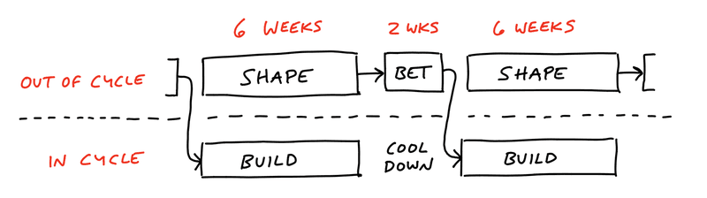
Shape Up is an alternative to Agile Scrum and Waterfall
Appetites and Batches instead of Story Points and Estimates
Pitches and Bets instead of User Stories and Backlogs
Six-week cycles instead of Sprints, with a two-week cooldown
Similar to Program Increments in SAFe
“[with Shape Up,] we don’t do daily stand ups, design sprints, development sprints, or anything remotely tied to a metaphor that includes being tired and worn out at the end. No backlogs, no Kanban, no velocity tracking, none of that.” (Jason Fried, 37Signals)

Slide 14
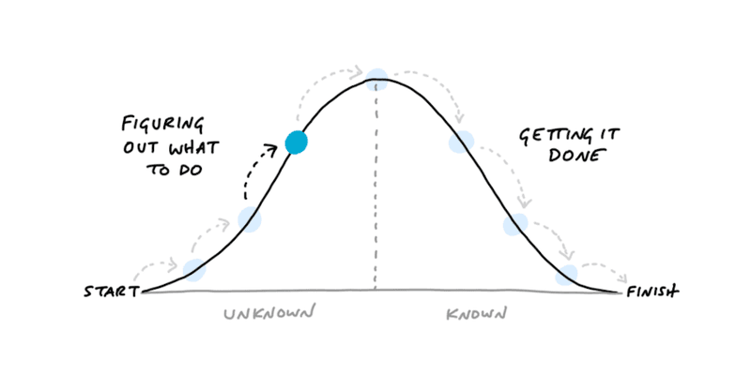
The Betting Table and Hill Charts
Decentralized lists and parallel work in private for pitches
A capped downside, is honoured with uninterrupted time
Important ideas will come back
The intent here is gamification of what to do next, or to put it another way, building appetite into the process of creation. As pitches and scope moves over the top of the hill, they move from uncertainty to certainty.

Slide 15
Scope Shaping
Breadboarding: places, affordances, connections
Fat Marker Sketches
Avoiding risks and rabbit-holes
The intent here is to keep scope shaping simple. Breadboards are simpler than wire frames and impose less burden on developers to make features look a certain way; Similarly, Fat Marker Sketches are very low fidelity.

Slide 16
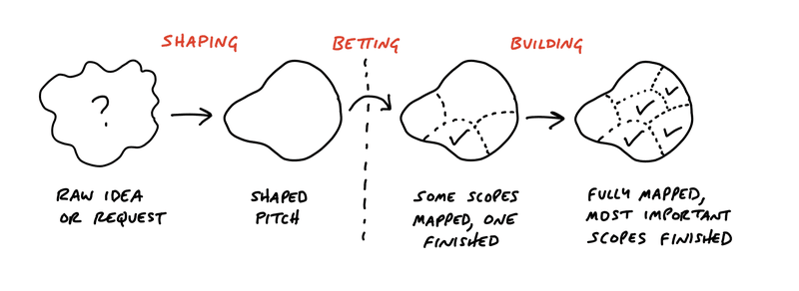
Ingredients of the Pitch
Problem – what are we solving?
Appetite – is the problem important enough that we would dedicate 2 or 6 weeks to solve it?
Solution – shape of the solution
Rabbit holes – spell these out
No Gos – set some guardrails

